Slide 1
MIT 6.875
Foundations of Cryptography
Lecture 8

Slide 2


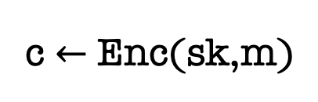
Secret-Key Encryption
(also called symmetric encryption)
m
c $←$ Enc(sk,m)
sk
sk
The Key Agreement Problem:
How did Alice and Bob get the same sk to begin with?!

Slide 3

Secret-Key Encryption
The Key Agreement Problem:
How did Alice and Bob get the same sk to begin with?!
Physical Exchange of Keys is Clunky and Impractical:
What if Alice and Bob have never met in person?
Even so, what if they need to refresh their keys?
Too expensive and cumbersome: Each user will need to store $N$ keys, too expensive!

Slide 4
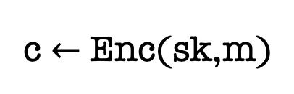
Secret-Key Encryption
c $←$ Enc(sk,m)
sk
sk
The Key Agreement Problem: Can Alice and Bob, who never previously met, exchange messages securely?

Slide 5
This Lecture and the Next
Key Exchange and Public-key Encryption: Definition and Properties
Constructions
1: Trapdoor Permutations (RSA)
2: Quadratic Residuosity/Goldwasser-Micali
3: Diffie-Hellman/El Gamal
4: Learning with Errors/Regev

Slide 6
Merkle (1974)

Slide 7
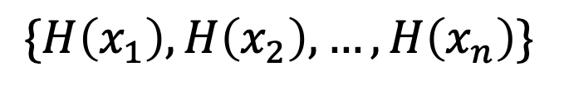
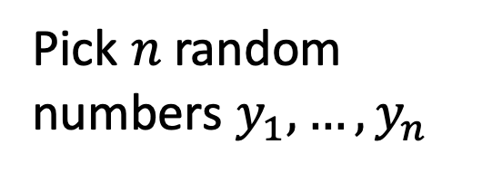
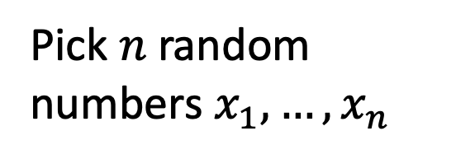
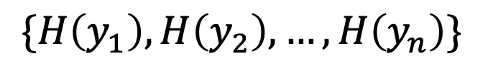
Merkle’s Idea
$\{H\left(x_{1}\right),H\left(x_{2}\right),…,H\left(x_{n}\right)\}$
$\{H\left(y_{1}\right),H\left(y_{2}\right),…,H\left(y_{n}\right)\}$
Pick $n$ random numbers $x_{1},…,x_{n}$
Pick $n$ random numbers $y_{1},…,y_{n}$
Assume that $H:\left[n^{2}\right]→[n^{2}]$ is an injective OWF.

Slide 8

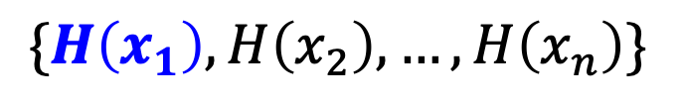
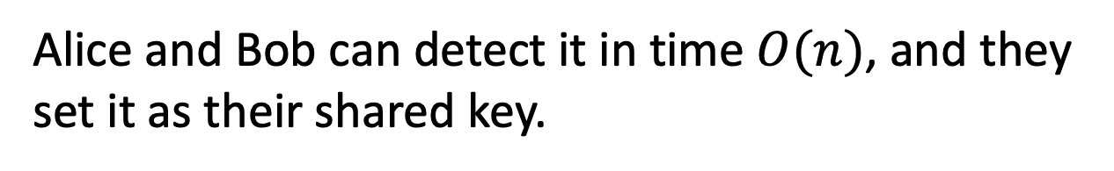
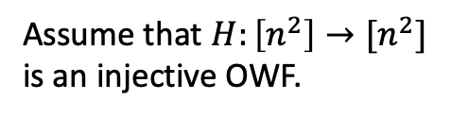
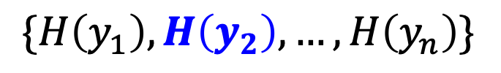
Assume that $H:\left[n^{2}\right]→[n^{2}]$ is an injective OWF.
Merkle’s Idea
$\{H\left(x_{1}\right),H\left(x_{2}\right),…,H\left(x_{n}\right)\}$
$\{H\left(y_{1}\right),H\left(y_{2}\right),…,H\left(y_{n}\right)\}$
Pick $n$ random numbers $x_{1},…,x_{n}$
Pick $n$ random numbers $y_{1},…,y_{n}$
There is a common number (say $x_{i}=y_{j}$ w.h.p.)
Alice and Bob can detect it in time $O(n)$, and they set it as their shared key.

Slide 9

Assume that $H:\left[n^{2}\right]→[n^{2}]$ is an injective OWF.
Merkle’s Idea
$\{H\left(x_{1}\right),H\left(x_{2}\right),…,H\left(x_{n}\right)\}$
$\{H\left(y_{1}\right),H\left(y_{2}\right),…,H\left(y_{n}\right)\}$
Pick $n$ random numbers $x_{1},…,x_{n}$
Pick $n$ random numbers $y_{1},…,y_{n}$
How long does it take Eve to compute the shared key?
She knows $i$ and $j$, but she needs to invert the OWF. Assuming the OWF is very strong, that is $Ω(n^{2})$ time!

Slide 10

Assume that $H:\left[n^{2}\right]→[n^{2}]$ is an injective OWF.
Merkle’s Idea
$\{H\left(x_{1}\right),H\left(x_{2}\right),…,H\left(x_{n}\right)\}$
$\{H\left(y_{1}\right),H\left(y_{2}\right),…,H\left(y_{n}\right)\}$
Pick $n$ random numbers $x_{1},…,x_{n}$
Pick $n$ random numbers $y_{1},…,y_{n}$
Problem: Only protects against quadratic-time Eves (still an excellent idea)

Slide 11
Diffie & Hellman 1976
Marked the birth of public-key cryptography.
Invented the Diffie-Hellman key exchange (conjectured to be secure against all poly-time attackers unlike Merkle).
Used to this day (e.g., TLS 1.3) albeit with different groups than what DH had in mind.
Turing Award 2015

Slide 12
Rivest, Shamir & Adleman 1978
Invented the RSA trapdoor permutation, public-key encryption and digital signatures.
RSA Signatures used to this day (e.g., TLS 1.3) in essentially the original form it was invented.
Turing Award 2002

Slide 13
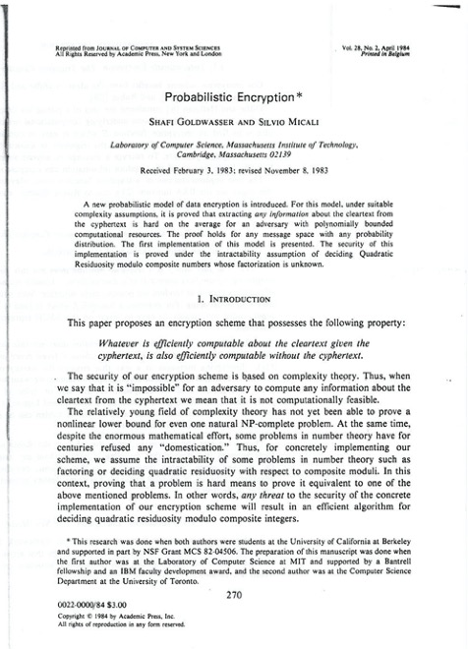
Goldwasser & Micali 1982
“Probabilistic Encryption”: defined what is now the gold-standard of security for public-key encryption (two equivalent defs: indistinguishability and semantic security)
GM-encryption: based on the difficulty of the quadratic residuosity problem, the first homomorphic encryption.
Turing Award 2012

Slide 14
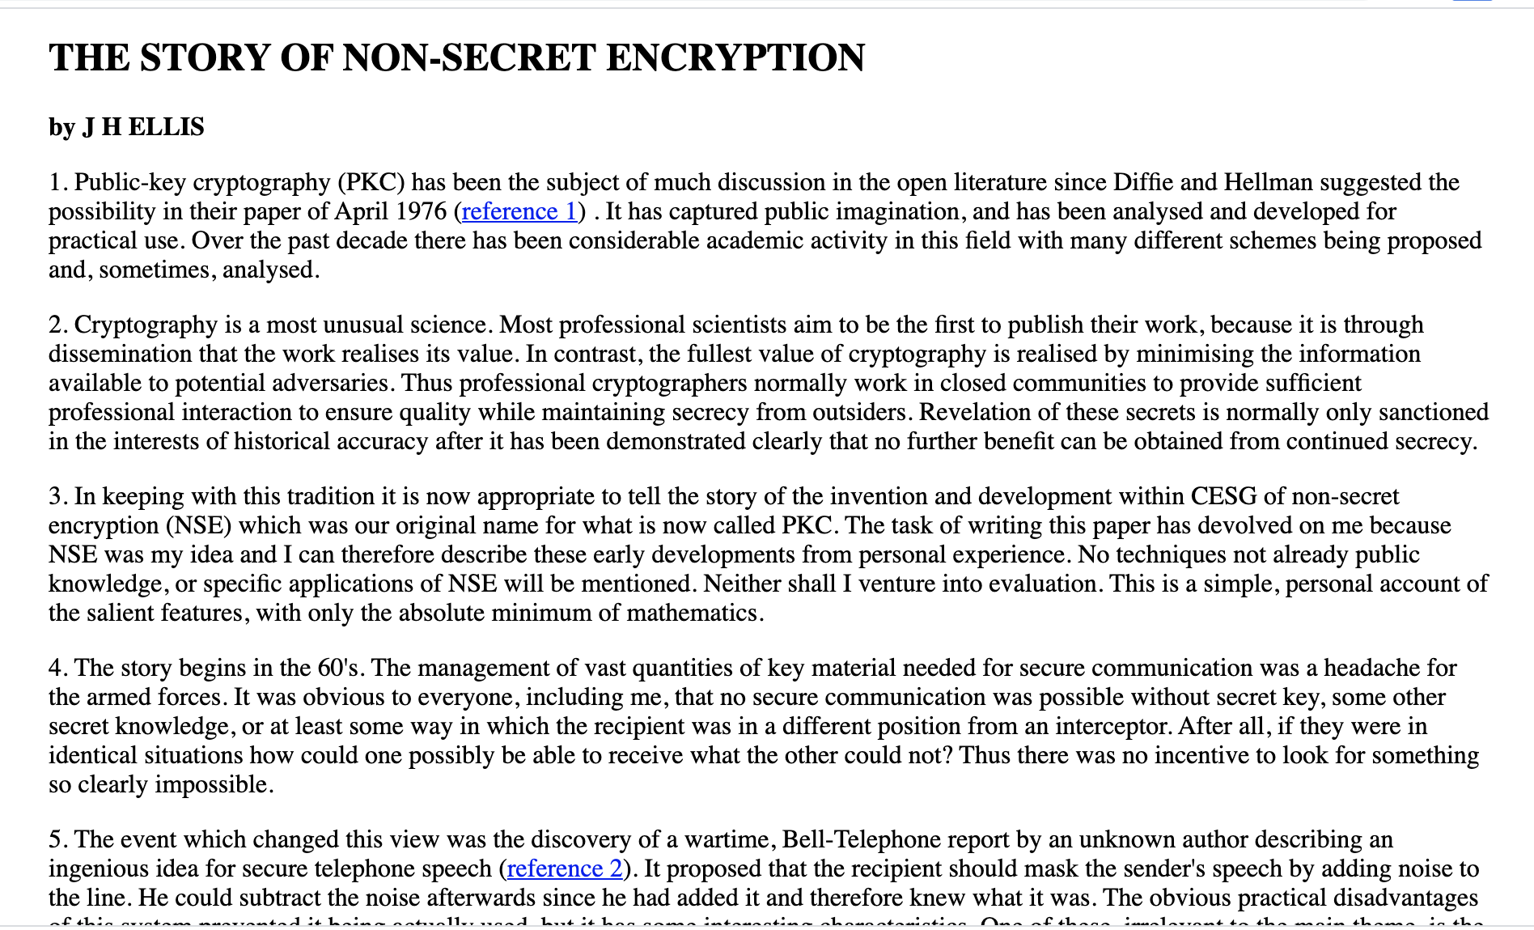
The Secret History of Public-key Encryption
Claimed to be invented in secret in early 1970s at the GCHQ (British NSA) by James Ellis, Clifford Cocks and Malcolm Williamson.

Slide 15
Public-Key Encryption
(also called asymmetric encryption)
GOAL:
Anyone can encrypt to Bob.
Bob, and only Bob, can decrypt.

Slide 16
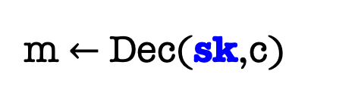
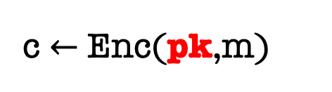
Public-Key Encryption
Bob
pk
m $←$ Dec(sk,c)
c $←$ Enc(pk,m)
sk
Bob generates a pair of keys, a public key pk, and a private (or secret) key sk.
Bob “publishes” pk and keeps sk to himself.
Alice encrypts m to Bob using pk
Bob decrypts using sk

Slide 17
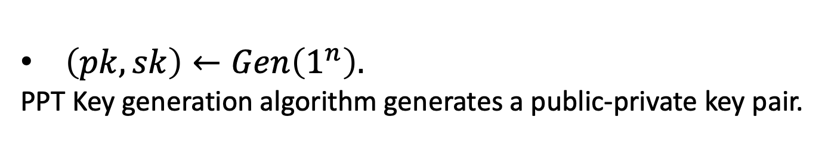
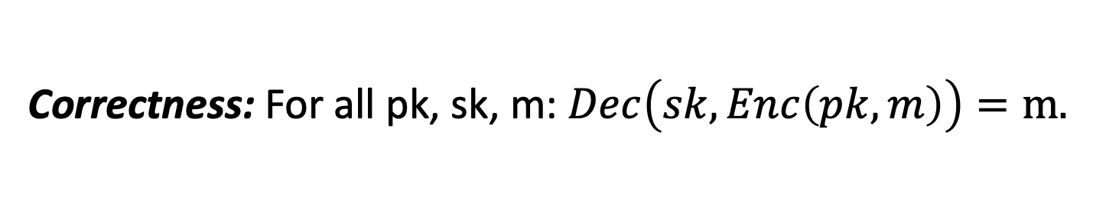
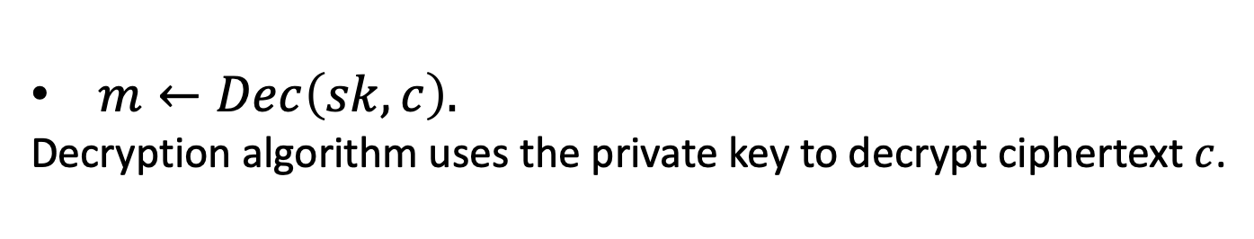
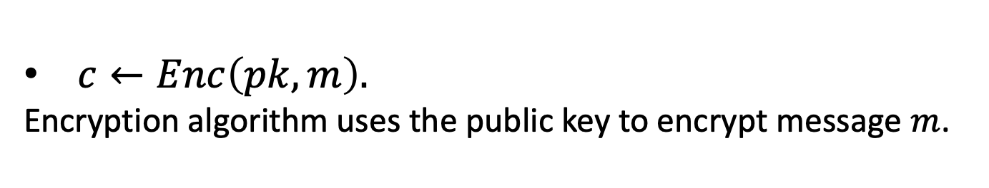
Public-Key Encryption
A triple of PPT algorithms $(Gen,Enc,Dec)$ s.t.
$\left(pk,sk\right)←Gen\left(1^{n}\right).$
PPT Key generation algorithm generates a public-private key pair.
$c←Enc\left(pk,m\right).$
Encryption algorithm uses the public key to encrypt message $m$.
$m←Dec\left(sk,c\right).$
Decryption algorithm uses the private key to decrypt ciphertext $c$.
Correctness: For all pk, sk, m: $Dec\left(sk,Enc\left(pk,m\right)\right)=m.$

Slide 18


How to Define Security
Bob
pk
c $←$ Enc(pk,m)
sk
Eve knows Bob’s public key pk
Eve sees polynomially many ciphertexts $c_{1},c_{2},…$ of messages $m_{1},m_{2},…$
Given this: Eve should not get any partial information about the set of messages.

Slide 19

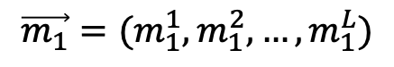
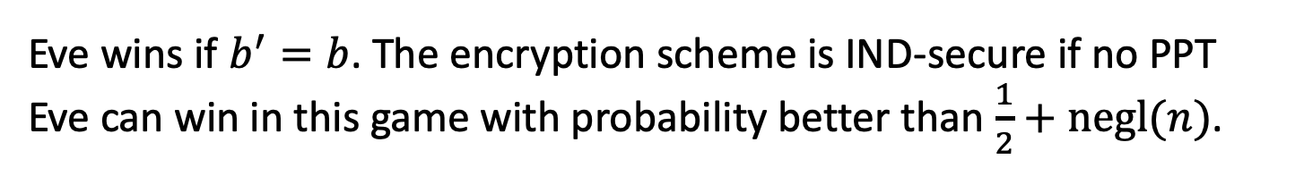
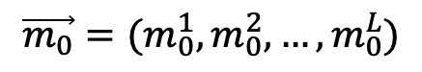
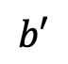
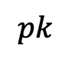
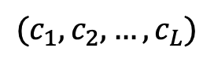
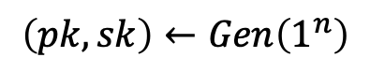
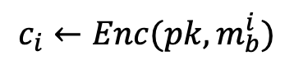
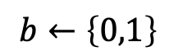

IND-Security (also called IND-CPA)
Challenger
Eve
$$\left(pk,sk\right)←Gen\left(1^{n}\right)$$
$$pk$$
$$\vec{m_{0}}=(m_{0}^{1},m_{0}^{2},…,m_{0}^{L})$$
$$s.t. \left|m_{0}^{i}\right|= {|m}_{1}^{i}| for all i$$
$$\vec{m_{1}}=(m_{1}^{1},m_{1}^{2},…,m_{1}^{L})$$
$$b←\left\{0,1\right\}$$
$$(c_{1},c_{2},…,c_{L})$$
$$c_{i}←Enc(pk,m_{b}^{i})$$
$$b′$$
This def is unachievable. Can you spot the issue?
Eve wins if $b^{′}=b$. The encryption scheme is IND-secure if no PPT Eve can win in this game with probability better than $\frac{1}{2}+negl(n)$.
Notes:
Encryption has to be probabilistic.

Slide 20
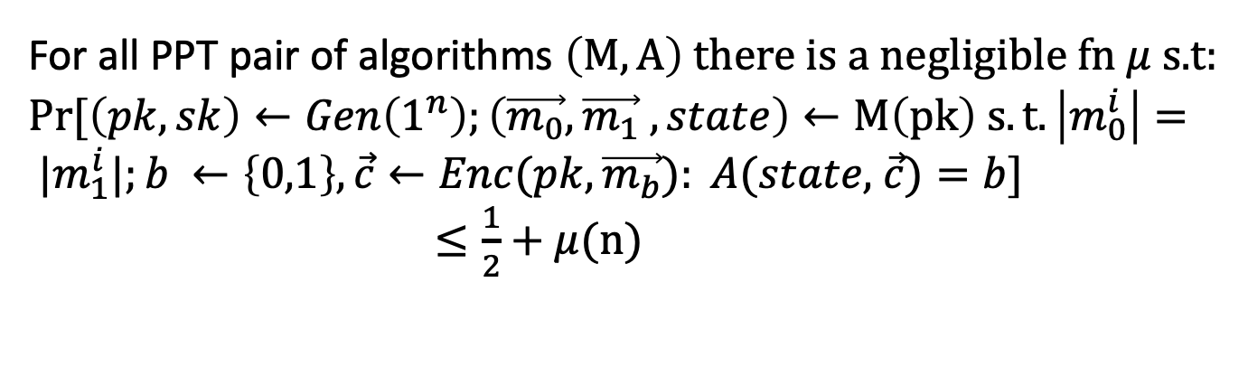
IND-Security
Challenger
Eve
This can be written in the more traditional (and cumbersome) notation as below, but the game is more fun.
For all PPT pair of algorithms $\left(M,A\right)$ there is a negligible fn $μ$ s.t:
$Pr⁡[\left(pk,sk\right)←Gen\left(1^{n}\right);\left(\vec{m_{0}},\vec{m_{1}} ,state\right)←M\left(pk\right) s.t.\left|m_{0}^{i}\right|= {|m}_{1}^{i}|;b ←\left\{0,1\right\}, \vec{c}←Enc(pk,\vec{m_{b}}): A(state,$ $\vec{c})=b]$
$≤\frac{1}{2}+$ $μ(n)$

Slide 21
An Alternative Definition
“Semantic Security”: the computational analog of Shannon’s perfect secrecy definition.
Turns out to be equivalent to IND-security (just as in Lec 1 but the proof is more complex)
We will stick to IND-security as it’s easy to work with.

Slide 22
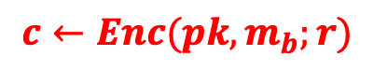
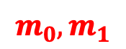
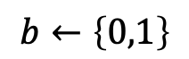
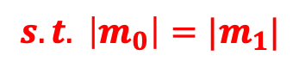
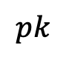
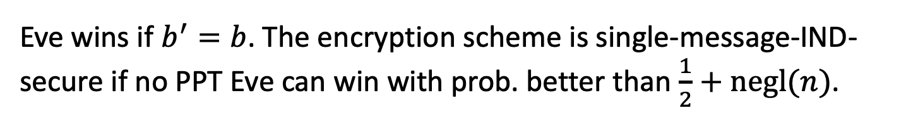
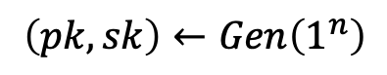
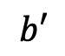
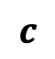
Simplifying the Definition: One Message to Many Message Security
Challenger
Eve
$$\left(pk,sk\right)←Gen\left(1^{n}\right)$$
$$pk$$
$$m_{0},m_{1}$$
$$s.t. \left|m_{0}\right|=|m_{1}|$$
$$b←\left\{0,1\right\}$$
$$c$$
$$c←Enc(pk,m_{b};r)$$
$$b′$$
Eve wins if $b^{′}=b$. The encryption scheme is single-message-IND-secure if no PPT Eve can win with prob. better than $\frac{1}{2}+negl(n)$.

Slide 23
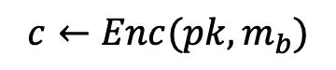
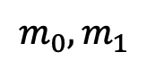
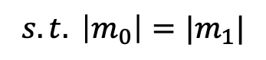
Simplifying the Definition: One Message to Many Message Security
Challenger
Eve
$$\left(pk,sk\right)←Gen\left(1^{n}\right)$$
$$pk$$
$$m_{0},m_{1}$$
$$s.t. \left|m_{0}\right|=|m_{1}|$$
$$b←\left\{0,1\right\}$$
$$c$$
$$c←Enc(pk,m_{b})$$
$$b′$$
Theorem: A public-key encryption scheme is IND-secure iff it is single-message IND-secure.
Notes:
Proof by hybrud argument
It is crucial that this is a public key scheme. For secret key schemes this theorem is simply not true. Think one-time pad.

Slide 24
Constructions of Public-Key Encryption
1: Trapdoor Permutations (RSA)
2: Quadratic Residuosity/Goldwasser-Micali
3: Diffie-Hellman/El Gamal
4: Learning with Errors/Regev

Slide 25
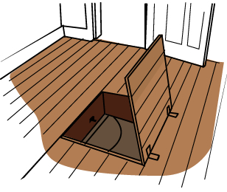
Trapdoor One-way Permutations
Trapdoor One-way Functions
One-way Functions
F
Easy to compute
Hard to invert
Easy to invert
domain
range
given a trapdoor
range
Domain = Range

Slide 26
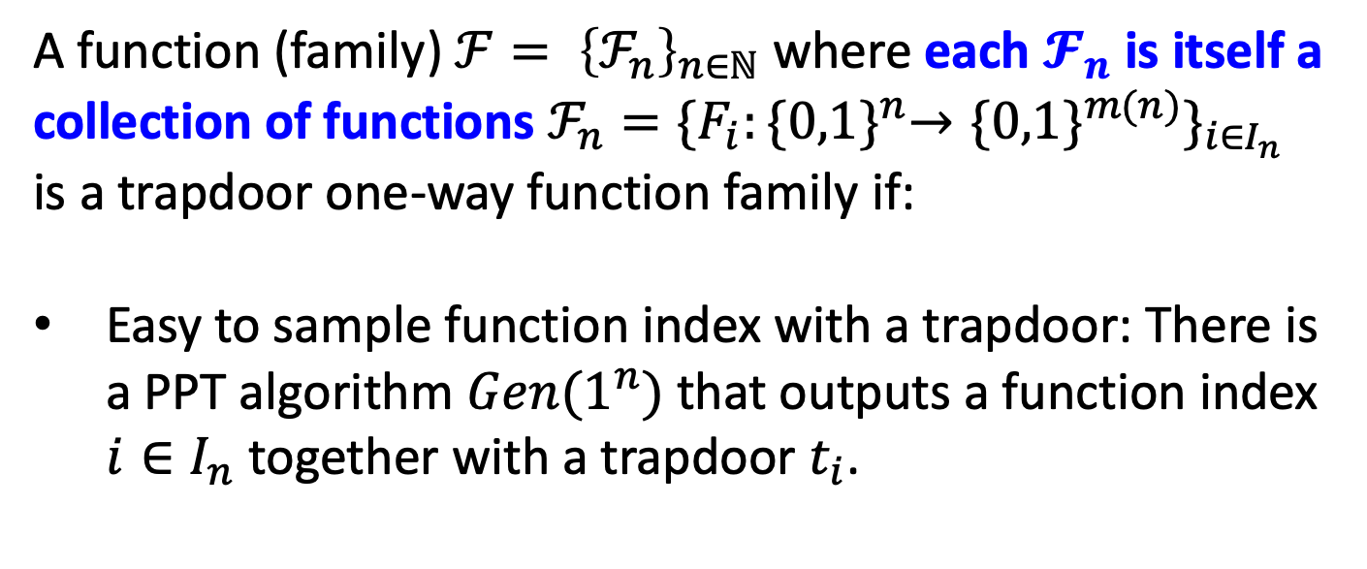
Trapdoor Functions: The Definition
A function (family${\text{) }ℱ= \left\{ℱ_{n}\right\}}_{n∈ℕ}$ where each $𝓕_{n}$ is itself a collection of functions $ℱ_{n}=\{F_{i}:{\{0,1\}}^{n}→{\{0,1\}}^{m(n)}\}_{i∈I_{n}}$ is a trapdoor one-way function family if:
Easy to sample function index with a trapdoor: There is a PPT algorithm $Gen(1^{n})$ that outputs a function index $i∈I_{n}$ together with a trapdoor $t_{i}$.

Slide 27
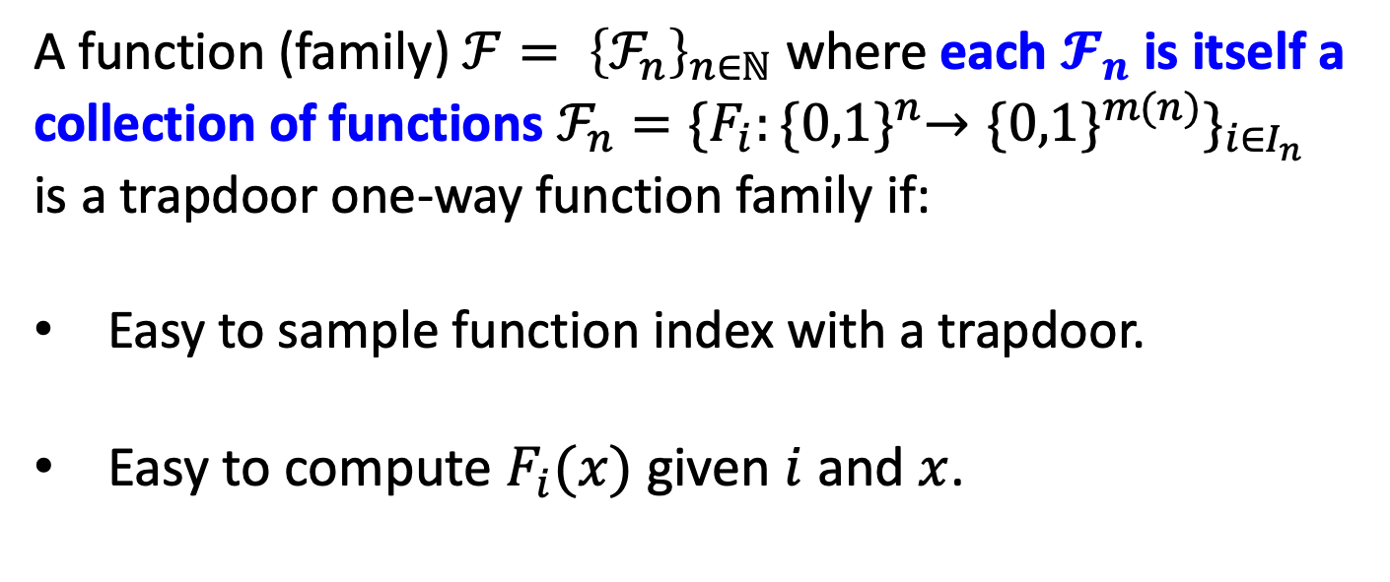
Trapdoor Functions: The Definition
A function (family${\text{) }ℱ= \left\{ℱ_{n}\right\}}_{n∈ℕ}$ where each $𝓕_{n}$ is itself a collection of functions $ℱ_{n}=\{F_{i}:{\{0,1\}}^{n}→{\{0,1\}}^{m(n)}\}_{i∈I_{n}}$ is a trapdoor one-way function family if:
Easy to sample function index with a trapdoor.
Easy to compute $F_{i}(x)$ given $i$ and $x$.

Slide 28
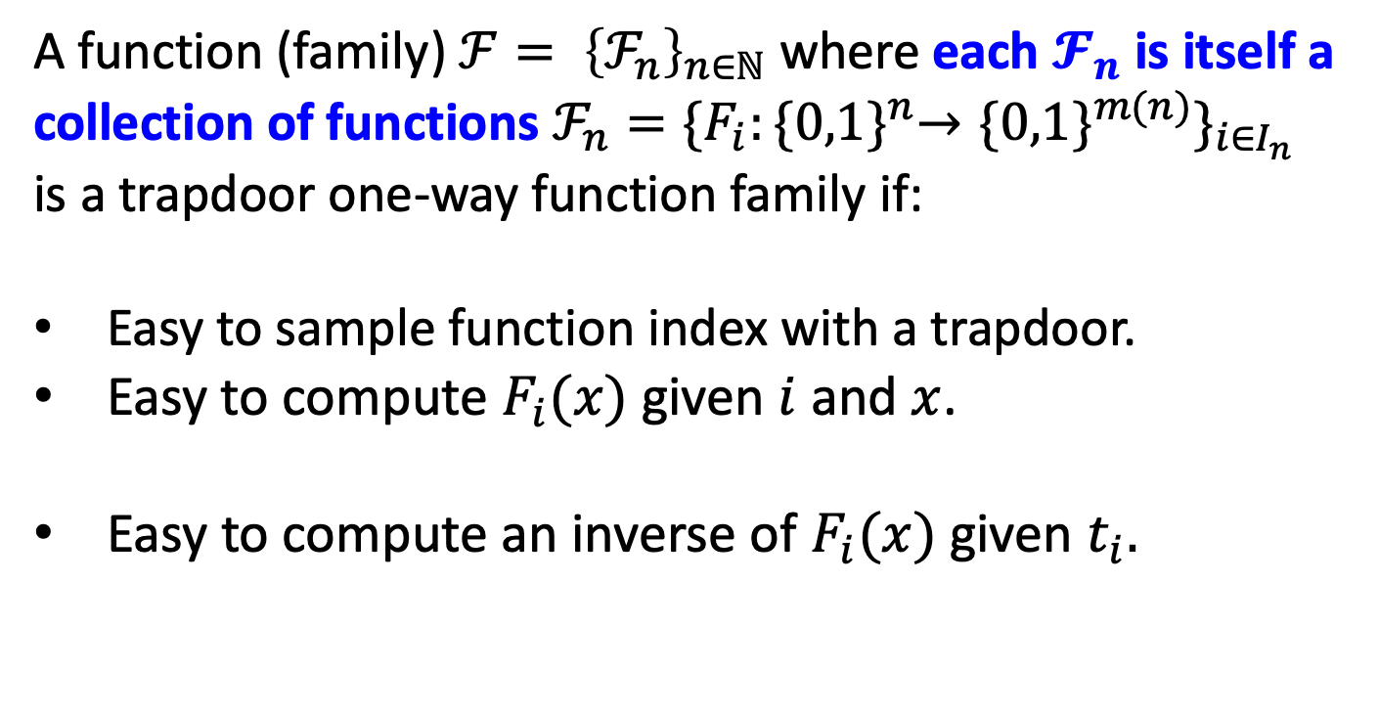
Trapdoor Functions: The Definition
A function (family${\text{) }ℱ= \left\{ℱ_{n}\right\}}_{n∈ℕ}$ where each $𝓕_{n}$ is itself a collection of functions $ℱ_{n}=\{F_{i}:{\{0,1\}}^{n}→{\{0,1\}}^{m(n)}\}_{i∈I_{n}}$ is a trapdoor one-way function family if:
Easy to sample function index with a trapdoor.
Easy to compute $F_{i}(x)$ given $i$ and $x$.
Easy to compute an inverse of $F_{i}(x)$ given $t_{i}.$

Slide 29
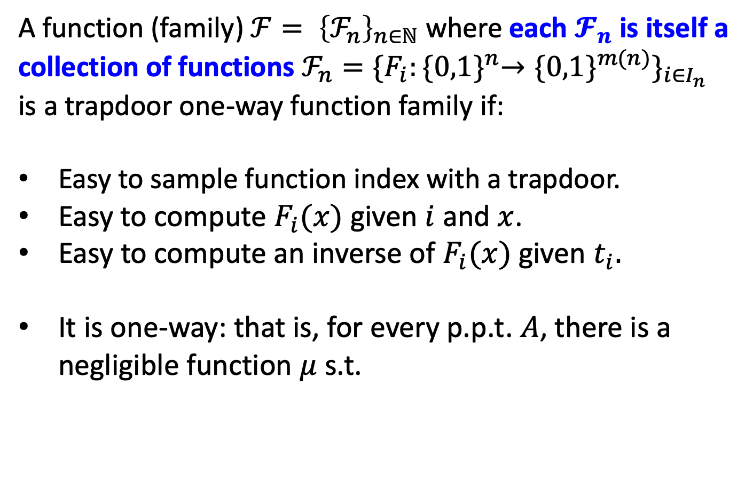
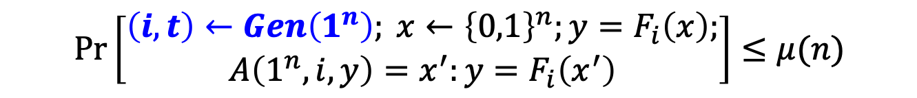
Trapdoor Functions: The Definition
A function (family${\text{) }ℱ= \left\{ℱ_{n}\right\}}_{n∈ℕ}$ where each $𝓕_{n}$ is itself a collection of functions $ℱ_{n}=\{F_{i}:{\{0,1\}}^{n}→{\{0,1\}}^{m(n)}\}_{i∈I_{n}}$ is a trapdoor one-way function family if:
Easy to sample function index with a trapdoor.
Easy to compute $F_{i}(x)$ given $i$ and $x$.
Easy to compute an inverse of $F_{i}(x)$ given $t_{i}.$
It is one-way: that is, for every p.p.t. $A$, there is a negligible function $μ$ s.t.
$$\operatorname{Pr}\left[\begin{aligned}\left(i,t\right)←Gen\left(1^{n}\right); x←{\left\{0,1\right\}}^{n};y=F_{i}\left(x\right); \\ A\left(1^{n},i,y\right)=x^{′}:y=F_{i}\left(x^{′}\right)\end{aligned}\right]≤μ(n)$$

Slide 30

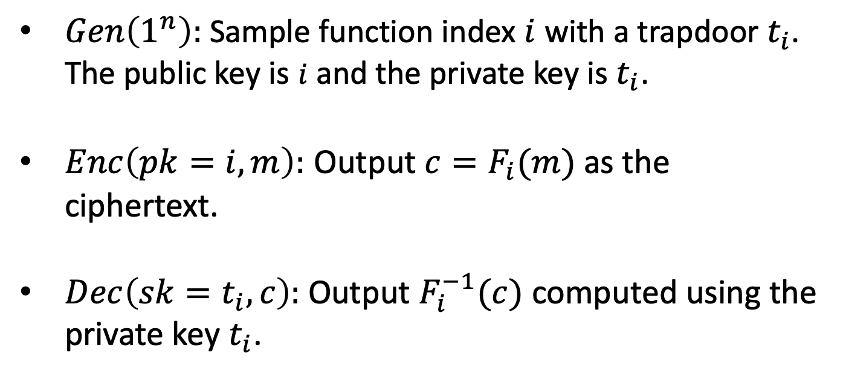
From Trapdoor Permutations to IND-Secure Public-key Encryption
$Gen\left(1^{n}\right):$ Sample function index $i$ with a trapdoor $t_{i}$. The public key is $i$ and the private key is$t_{i}$.
$Enc\left(pk=i,m\right):$ Output ${c=F}_{i}(m)$ as the ciphertext.
$Dec\left(sk=t_{i},c\right):$ Output $F_{i}^{−1}(c)$ computed using the private key $t_{i}$.
Could reveal partial info about m!
So, not IND-secure!

Slide 31
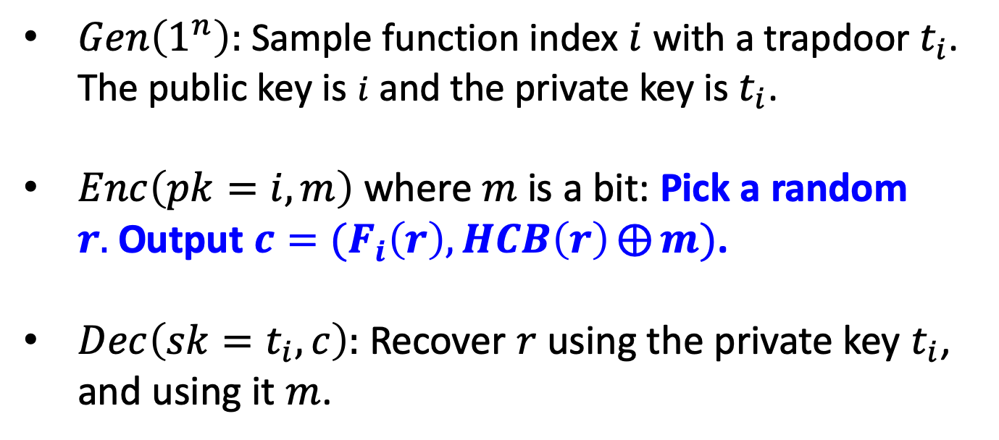
From Trapdoor Permutations to IND-Secure Public-key Encryption
$Gen\left(1^{n}\right):$ Sample function index $i$ with a trapdoor $t_{i}$. The public key is $i$ and the private key is$t_{i}$.
$Enc\left(pk=i,m\right)$ where $m$ is a bit: Pick a random $r.$Output ${c=(F}_{i}\left(r\right),HCB\left(r\right)⨁{m})$.
$Dec\left(sk=t_{i},c\right):$ Recover $r$ using the private key $t_{i}$, and using it $m$.
This is IND-secure: Proof by Hybrid argument (exercise).

Slide 32
Trapdoor Permutations: Candidates
Trapdoor Permutations are exceedingly rare.
Two candidates (both need factoring to be hard):
The RSA (Rivest-Shamir-Adleman) Function
The RSA (Rivest-Shamir-Adleman) Function
The Rabin/Blum-Williams Function

Slide 33
Review: Number Theory
Let’s review some number theory from L5-7.
Let $N=pq$ be a product of two large primes.
Fact: $Z_{N}^{∗}=\{a ∈Z_{N}:gcd\left(a,N\right)=1\}$ is a group.
group operation is multiplication mod $N$.
inverses exist and are easy to compute (how so?)
the order of the group is
$$ϕ\left(N\right)=\left(p−1\right)(q−1)$$

Slide 34
The RSA Trapdoor Permutation
Today: Let $e$ be an integer with $\gcd\left(e,ϕ(N)\right)=1.$ Then, the map $F_{N,e}\left(x\right)=x^{e} mod N$ is a trapdoor permutation.
Key Fact: Given $d$ such that $ed=1 mod ϕ\left(N\right)$, it is easy to compute $x$ given $x^{e}$.
Proof: ${(x}^{e})^{d}=x^{kϕ\left(N\right)+1}=(x^{ϕ\left(N\right)})^{k}∙x=x mod N$
(for some integer k)
This gives us the RSA trapdoor permutation collection.
$${\{F}_{N,e}:\gcd\left(e,N\right)=1\}$$
Trapdoor for inversion: $d=e^{−1}mod ϕ\left(N\right)$.

Slide 35
The RSA Trapdoor Permutation
Today: Let $e$ be an integer with $\gcd\left(e,ϕ(N)\right)=1.$ Then, the map $F_{N,e}\left(x\right)=x^{e} mod N$ is a trapdoor permutation.
Hardness of inversion without trapdoor = RSA assumption
given $N,e$ (as above) and $x^{e}$mod N, hard to compute $x.$
We know that if factoring is easy, RSA is broken (and that’s the only known way to break RSA)
Major Open Problem: Are factoring and RSA equivalent?

Slide 36
The RSA Trapdoor Permutation
Today: Let $e$ be an integer with $\gcd\left(e,ϕ(N)\right)=1.$ Then, the map $F_{N,e}\left(x\right)=x^{e} mod N$ is a trapdoor permutation.
Hardcore bits (galore) for the RSA trapdoor one-way perm:
The Goldreich-Levin bit $GL\left(r;r^{′}\right)= \left\langle r,r′\right\rangle mod 2$
The least significant bit $LSB\left(r\right)$
The “most significant bit” ${HALF}_{N}\left(r\right)=1$ iff $r<N/2$
In fact, any single bit of $r$ is hardcore.

Slide 37
RSA Encryption
$Gen\left(1^{n}\right):$Let $N=pq$ and $\left(e,d\right)$ be such that $ed=1 mod φ(N)$. Let $pk=(N,e)$ and let $sk=d$.
$Enc\left(pk,b\right)$ where $b$ is a bit: Generate random $r∈Z_{N}^{∗}$and output $r^{e} mod N$ and $LSB\left(r\right)⨁m$.
$Dec\left(sk,c\right)$: Recover $r$ via RSA inversion.
IND-secure under the RSA assumption: given $N,e$ (as above) and $r^{e}$mod N, hard to compute $r.$

